Slide 1

PySpark Distributed Computing Leveraging the Functional Model
Johannes Ahlmann, PyCon Ireland, 2015-10-24

Slide 2
Parallel Programming
(deterministic)
Concurrency
(non-deterministic)
Functional
Bandwidth
Node failure
Connectvity
MapReduce
Spark
CAP theorem
Erlang
Akka
Pykka
Distr.
Immutable data
Ref. transparency
Declarative
Streams
Haskell
Erlang
Clojure, Scala
Side effects
Low-level abstractions
Pool.map
Resource contention
Deadlocks
Thrashing
STM
Pypy
Twisted
Local

Slide 3
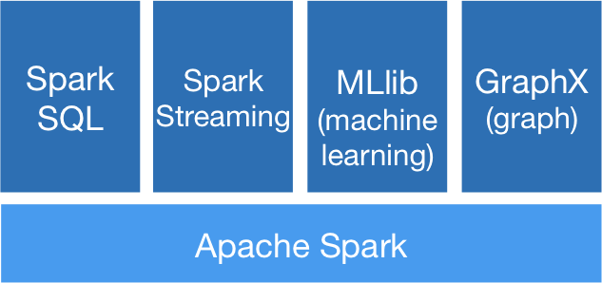
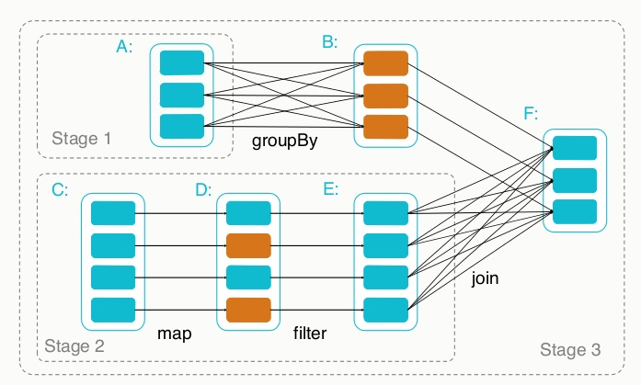
What is Apache
Fast and general engine for large-scale data processing
Multi-stage in-memory primitives
Supports Iterative Algorithms
High-Level Abstractions
Extensible; integrated stack of libraries

Slide 4
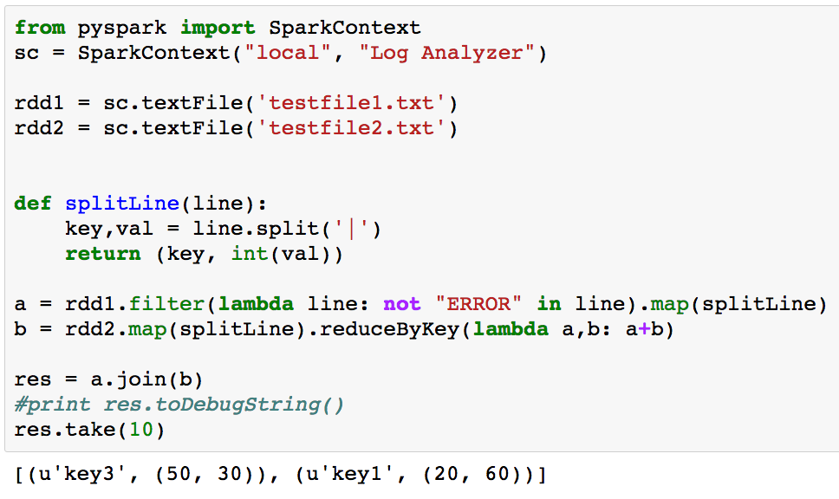
Spark Example

Slide 5
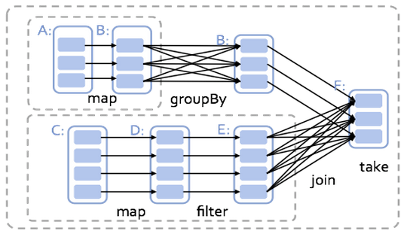
Operator Graph

Slide 6

vs.
Arbitrary operator graph
Lazy eval of lineage graph => optimization
Off-heap use of large memory
Native integration with python
MapReduce

Slide 7
RDD
Resilient Distributed Datasets are primary abstraction in Spark
fault-tolerant collection
parallelized collections
hadoop datasets
can be cached for reuse
extensions (SchemaRDD)
Transformations | Actions
map() | reduce()
filter() | collect()
flatMap() | count()
mapPartitions() | take()
sample() | takeSample()
union() | takeOrdered()
intersection() | saveAsTextFile()
distinct() | saveAsSequenceFile()
groupByKey() | countByKey()
reduceByKey() | foreach()
aggregateByKey()
sortByKey()
join()
cogroup()
cartesian()
coalesce()
repartition()

Slide 8
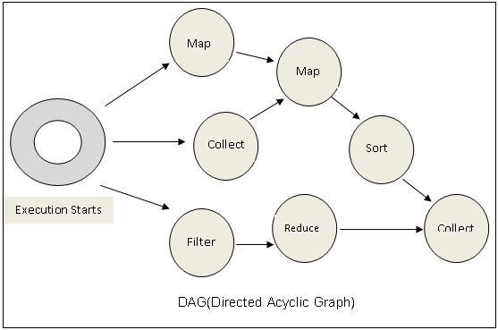
Lifetime of an RDD
create from data
local collection
hadoop data set
lazily combine RDDs using transformations
map()
join()
etc.
call an RDD 'action' on it (collect(), count(), etc.) to "collapse" tree:
Operator DAG is constructed
Split into stages of tasks
Launch tasks via cluster manager
Execute tasks on local machines
store/consume results

Slide 9
Integrated Libraries

Slide 10

Takeaways
Spark...
feels like native python, very nice API
adds awesome Distributed Computing and Parallel Programming capabilities to python
comes with batteries included (SQL, GraphX, MLLib, Streaming, etc.)
can be used from the start for exploratory programming

Slide 11



Getting Started
Download Spark; ./bin/pyspark
docker-spark
Spark on Amazon EMR
Berkeley MOOC setup (vagrant, virtualbox, notebook)

Slide 12
Backups

Slide 13
Pure Functions
f: a -> b
Takes an “a” and returns a “b”
Does not access global state and has no side-effects
Function invocation can be substituted with the function body
Can be used in an expression
Can be “memoized”
Is idempotent

Slide 14
Pure
Effects
stateless
no sequence, no time
non-strict
x = 1+4 (equality)
“x” can be substituted by the expression (referential transparency)
idempotent
expressions, algebra
stateful
fixed sequence, time
strict
x := x + 1 (assignment)
“x” = changeable memory “slot”
Pure functions by themselves are useless. We want to interact with storage, network, screen etc.
We need both pure functions and (controlled, contained) effects

Slide 15
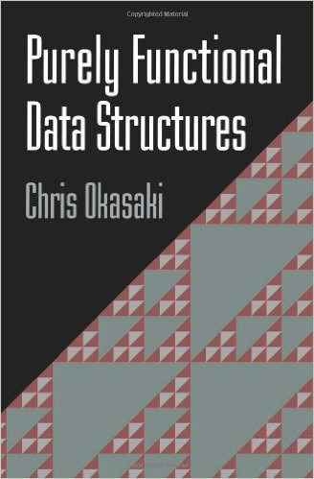
Immutable State
append([1, 2, 3], 4) => [1, 2, 3, 4]
[1, 2, 3] remains unchanged
Inherently thread-safe
Can be shared freely
“Everything is atomic”

Slide 16
Streams (Generators, Iterators)
Declarative
Imperative
xs = [1, 2, 3];
return xs.map(x => x+1);
xs = [1, 2, 3];
res = []
for (int i = 0; i < 3; i++) {
res.append(xs[i] + 1);
}
return res;
Which do you think is easier to parallelize?

Slide 17
Stream Fusion
xs
.map(x => (x+1)*2)
xs .map(x => x+1)
.map(y => y*2)
Iff functions are pure, we can
combine
reorder
optimize the entire chain
If application is lazy, we can optimize across functions as well

